Slide 1
Chapter 4 Linked Lists

Slide 2
Outline
Inserting and deleting nodes in a list
Implementation stack by linked lists
Implementation queue by linked lists
Algorithm for adding polynomials
Equivalence relations

Slide 3
Inserting and deleting nodes in a list
用list的方式實作出可以刪除功能和將字母按順序插入功能
實作步驟
建立node的結構(struct)
主要function
插入: insert()
刪除: delete()

Slide 4
Inserting and deleting nodes in a list
insert a
insert z
insert k
a
NULL
a
z
NULL
a
k
z
NULL

Slide 5
Inserting and deleting nodes in a list
delete k
delete a
insert n
a
z
NULL
z
NULL
n
z
NULL

Slide 6
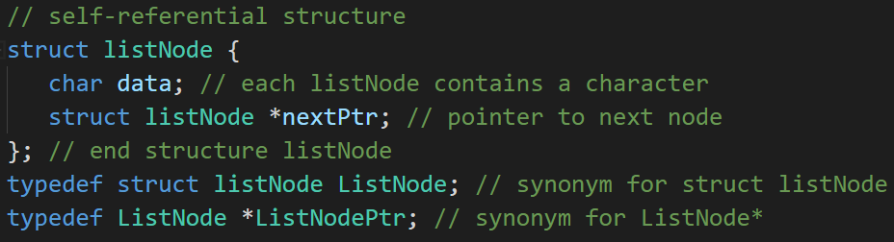
Inserting and deleting nodes in a list
建立node的結構(struct)

Slide 7
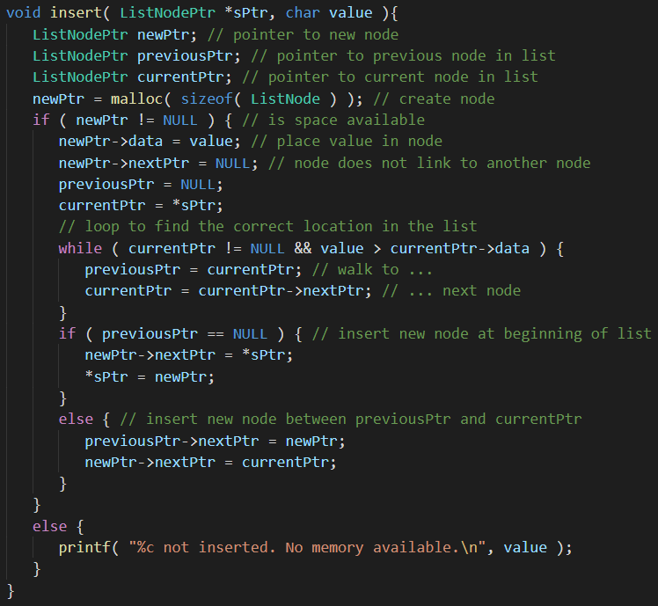
插入: push()

Slide 8
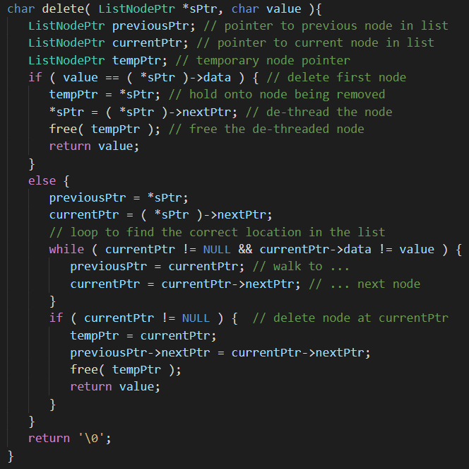
刪除: delete()

Slide 9
Implementation stack by linked lists
用list實作stack的插入和刪除功能
實作步驟
建立node的結構(struct)
主要function
插入: push()
刪除: pop()

Slide 10
Implementation stack by linked lists
push 10
push 35
push 80
10
NULL
35
10
NULL
80
35
10
NULL

Slide 11
Implementation stack by linked lists
push 40
pop
pop
40
80
35
10
NULL
80
35
10
NULL
35
10
NULL

Slide 12
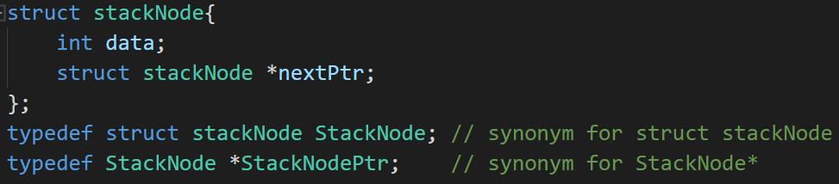
Implementation stack by linked lists
建立node的結構(struct)

Slide 13
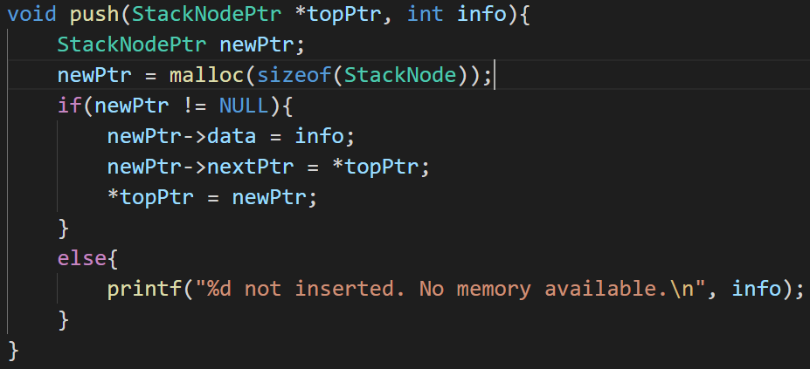
Implementation stack by linked lists
插入: push()

Slide 14
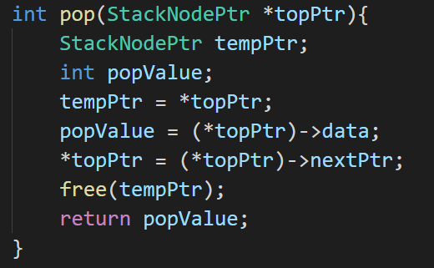
Implementation stack by linked lists
插入: pop()

Slide 15
Implementation queue by linked lists
用list實作Queue的插入和刪除功能
實作步驟
建立node的結構(struct)
主要function
插入: enqueue()
刪除: dequeue()

Slide 16
Implementation queue by linked lists
enqueue a
enqueue z
enqueuer k
a
NULL
a
z
NULL
a
z
k
NULL

Slide 17
Implementation queue by linked lists
enqueue f
dequeue
dequeue
a
z
k
f
NULL
z
k
f
NULL
k
f
NULL

Slide 18
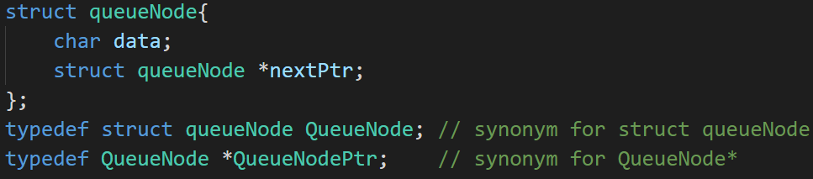
Implementation queue by linked lists
建立node的結構(struct)

Slide 19
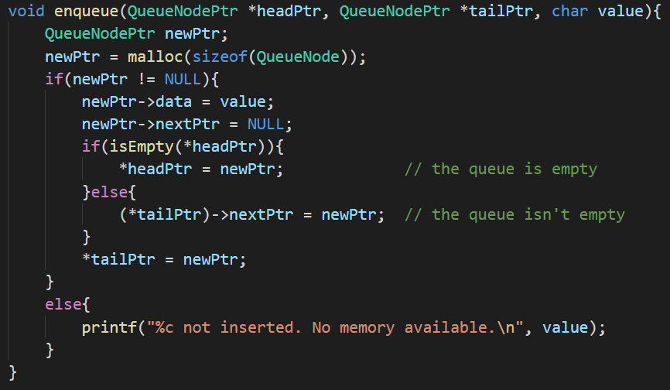
Implementation queue by linked lists
插入: enqueue()

Slide 20
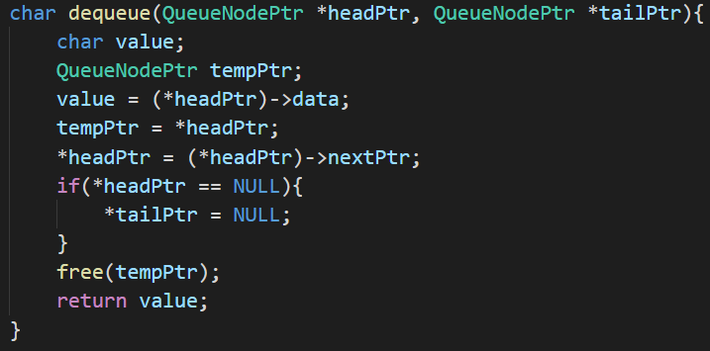
Implementation queue by linked lists
刪除: dequeue()

Slide 21
Algorithm for adding polynomials
用list實作將兩個多項式相加
實作步驟
建立多項式node的結構(struct)
主要function
padd()
attach()

Slide 22

Algorithm for adding polynomials
polynomial a: ${3x}^{14}+{2x}^{8}+1$
polynomial b: ${8x}^{14}−{3x}^{10}+{10x}^{6}$
polynomial c = polynomial a + polynomial b
3
14
2
8
1
0
NULL
8
14
-3
10
10
6
NULL
11
14
2
8
-3
10
10
6
1
0
NULL

Slide 23
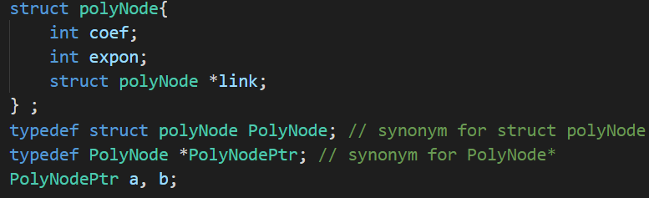
Algorithm for adding polynomials
建立多項式node的結構(struct)

Slide 24
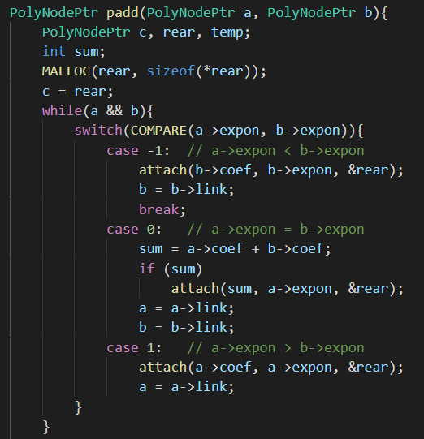
Algorithm for adding polynomials
padd()
Notes:
P163

Slide 25
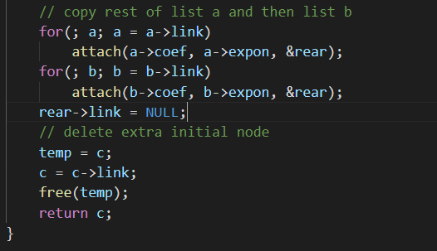
Algorithm for adding polynomials
padd()
Notes:
P163

Slide 26
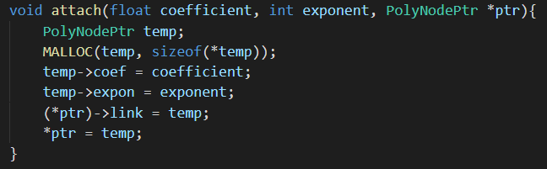
Algorithm for adding polynomials
attach()
Notes:
P164

Slide 27
Equivalence relations
用list實作等價關係
實作步驟
建立node的結構(struct)
輸入equivalence pairs
輸出equivalence classes

Slide 28









Equivalence relations
init
[0] | [1] | [2] | [3] | [4] | [5] | [6] | [7] | [8] | [9] | [10] | [11]
$$0≡4$$
$$3≡1$$
seq[]
$$6≡10$$
$$8≡9$$
NULL
NULL
NULL
NULL
NULL
NULL
NULL
NULL
NULL
NULL
NULL
NULL
$$7≡4$$
$$6≡8$$
[0] | [1] | [2] | [3] | [4] | [5] | [6] | [7] | [8] | [9] | [10] | [11]
1 | 1 | 1 | 1 | 1 | 1 | 1 | 1 | 1 | 1 | 1 | 1
$$3≡5$$
out[]
$$2≡11$$
$$11≡0$$
1 = True

Slide 29

Equivalence relations
Phase 1: input the equivalence pairs
[0] | [1] | [2] | [3] | [4] | [5] | [6] | [7] | [8] | [9] | [10] | [11]
$$0≡4$$
$$3≡1$$
seq[]
$$6≡10$$
$$8≡9$$
NULL
NULL
NULL
NULL
NULL
NULL
NULL
NULL
NULL
NULL
$$7≡4$$
4
0
$$6≡8$$
$$3≡5$$
NULL
NULL
$$2≡11$$
$$11≡0$$

Slide 30

Equivalence relations
Phase 1: input the equivalence pairs
[0] | [1] | [2] | [3] | [4] | [5] | [6] | [7] | [8] | [9] | [10] | [11]
$$0≡4$$
$$3≡1$$
seq[]
$$6≡10$$
$$8≡9$$
NULL
NULL
NULL
NULL
NULL
NULL
NULL
NULL
4
3
1
0
$$7≡4$$
$$6≡8$$
$$3≡5$$
NULL
NULL
NULL
NULL
$$2≡11$$
$$11≡0$$

Slide 31

Equivalence relations
Phase 1: input the equivalence pairs
[0] | [1] | [2] | [3] | [4] | [5] | [6] | [7] | [8] | [9] | [10] | [11]
$$0≡4$$
$$3≡1$$
seq[]
$$6≡10$$
$$8≡9$$
NULL
NULL
NULL
NULL
NULL
NULL
4
3
1
0
10
6
$$7≡4$$
$$6≡8$$
$$3≡5$$
NULL
NULL
NULL
NULL
NULL
NULL
$$2≡11$$
$$11≡0$$

Slide 32

Equivalence relations
Phase 1: input the equivalence pairs
[0] | [1] | [2] | [3] | [4] | [5] | [6] | [7] | [8] | [9] | [10] | [11]
$$0≡4$$
$$3≡1$$
seq[]
$$6≡10$$
$$8≡9$$
NULL
NULL
NULL
NULL
4
3
1
0
10
9
8
6
$$7≡4$$
$$6≡8$$
$$3≡5$$
NULL
NULL
NULL
NULL
NULL
NULL
NULL
NULL
$$2≡11$$
$$11≡0$$

Slide 33

Equivalence relations
Phase 1: input the equivalence pairs
[0] | [1] | [2] | [3] | [4] | [5] | [6] | [7] | [8] | [9] | [10] | [11]
$$0≡4$$
$$3≡1$$
seq[]
$$6≡10$$
$$8≡9$$
NULL
NULL
NULL
4
3
1
7
10
4
9
8
6
$$7≡4$$
$$6≡8$$
$$3≡5$$
NULL
NULL
NULL
NULL
NULL
NULL
NULL
NULL
0
$$2≡11$$
$$11≡0$$
NULL

Slide 34

Equivalence relations
Phase 1: input the equivalence pairs
[0] | [1] | [2] | [3] | [4] | [5] | [6] | [7] | [8] | [9] | [10] | [11]
$$0≡4$$
$$3≡1$$
seq[]
$$6≡10$$
$$8≡9$$
NULL
NULL
NULL
4
3
1
7
8
4
6
8
6
$$7≡4$$
$$6≡8$$
$$3≡5$$
NULL
NULL
NULL
NULL
NULL
NULL
0
10
9
$$2≡11$$
$$11≡0$$
NULL
NULL
NULL

Slide 35

Equivalence relations
Phase 1: input the equivalence pairs
[0] | [1] | [2] | [3] | [4] | [5] | [6] | [7] | [8] | [9] | [10] | [11]
$$0≡4$$
$$3≡1$$
seq[]
$$6≡10$$
$$8≡9$$
NULL
NULL
4
3
5
7
3
8
4
6
8
6
$$7≡4$$
$$6≡8$$
$$3≡5$$
NULL
NULL
NULL
NULL
NULL
NULL
1
0
10
9
$$2≡11$$
$$11≡0$$
NULL
NULL
NULL
NULL

Slide 36

Equivalence relations
Phase 1: input the equivalence pairs
[0] | [1] | [2] | [3] | [4] | [5] | [6] | [7] | [8] | [9] | [10] | [11]
$$0≡4$$
$$3≡1$$
seq[]
$$6≡10$$
$$8≡9$$
4
3
11
5
7
3
8
4
6
8
6
2
$$7≡4$$
$$6≡8$$
$$3≡5$$
NULL
NULL
NULL
NULL
NULL
NULL
NULL
NULL
1
0
10
9
$$2≡11$$
$$11≡0$$
NULL
NULL
NULL
NULL

Slide 37

Equivalence relations
Phase 1: input the equivalence pairs
[0] | [1] | [2] | [3] | [4] | [5] | [6] | [7] | [8] | [9] | [10] | [11]
$$0≡4$$
$$3≡1$$
seq[]
$$6≡10$$
$$8≡9$$
11
3
11
5
7
3
8
4
6
8
6
0
$$7≡4$$
$$6≡8$$
$$3≡5$$
NULL
NULL
NULL
NULL
NULL
NULL
4
1
0
10
9
2
$$2≡11$$
$$11≡0$$
NULL
NULL
NULL
NULL
NULL
NULL

Slide 38
Equivalence relations
New class: 0 11 4 7 2
New class: 1 3 5
New class: 6 8 10 9
Phase 2: output the equivalence classes
[0] | [1] | [2] | [3] | [4] | [5] | [6] | [7] | [8] | [9] | [10] | [11]
$$0≡4$$
$$3≡1$$
seq[]
$$6≡10$$
$$8≡9$$
11
3
11
5
7
3
8
4
6
8
6
0
$$7≡4$$
$$6≡8$$
$$3≡5$$
NULL
NULL
NULL
NULL
NULL
NULL
4
1
0
10
9
2
$$2≡11$$
$$11≡0$$
NULL
NULL
NULL
NULL
NULL
NULL

Slide 39
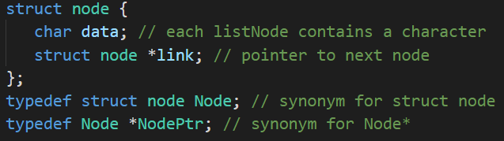
Equivalence relations
建立node的結構(struct)

Slide 40
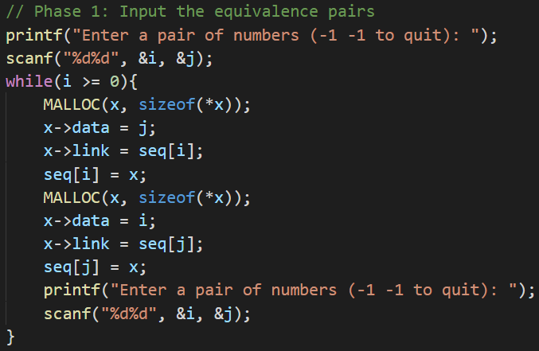
Equivalence relations
輸入equivalence pairs

Slide 41
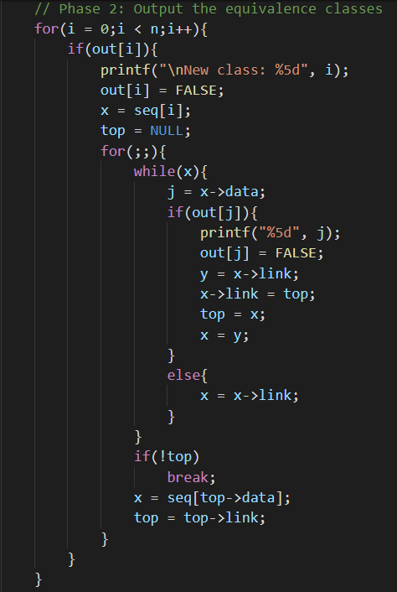
Equivalence relations
輸出equivalence classes

